Slide 1


Entropy of an Ideal Gas
For Monatomic ideal gas
The Sackur-Tetrode equation
Example on p.78
1 mole of Helium ≅ 4 amu,
V=0.025 m³, U=3700 J at room temperature and atmospheric pressure.
Find the entropy.
$$U=\frac{3}{2}nRT$$
$$9.1{10}^{24}k_{B}=126 J/K$$

Slide 2
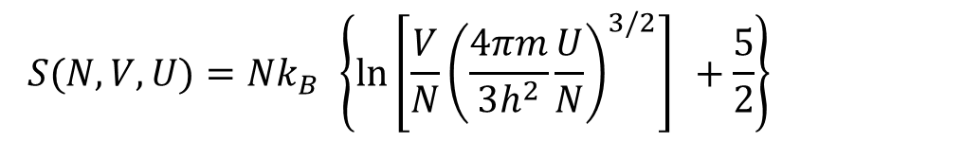
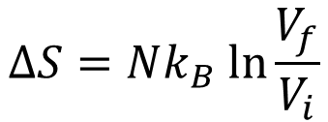
The entropy of an ideal gas depends on its volume, energy, and number of particles.
An increase of any of these will increase the entropy.
Example: If the volume changes from V_{i} to V_{f} while U and N are held fixed, the entropy changes by
$$S(N,V,U)=Nk_{B} \left\{\ln\left[\frac{V}{N}{\left(\frac{4πm}{3h^{2}}\frac{U}{N}\right)}^{3/2}\right] +\frac{5}{2}\right\}$$
(U & N are fixed)
$$∆S=Nk_{B} ln\frac{V_{f}}{V_{i}}$$
This is the case of isothermal expansion, where the gas pushes on a piston, doing mechanical work, while heat is supplied simultaneously from outside to keep the gas at constant T.
The entropy increase because of the heat input.

Slide 3
Assignment#4 Due 2/25/2022
2.17, 2.19, 2.26, and 2.31 2.33.
Problems for practice on Friday:
2.1, 2.2, 2.5, 2.6, 2.8, 2.28, 2.32, and 2.36.
(These are all problems from this chapter)
Next: Ch 3
Exam 1 Covering Ch 1 through Ch 3
3/4/2022

Slide 4
Ch 3
Interactions and Implications
Exchange of energy, particles and volume, etc.

Slide 5
The approach of thermal physics
Fundamental assumptions, definitions
Multiplicity, probability, entropy, etc….
Thermodynamics
Thermodynamic laws, identities…
Applications of thermodynamics

Slide 6


We already know that (from Ch 2) S is S(U, V, N)
We also know that for a composite system
$S=S_{A}+S_{B}+ …$
The Sackur-Tetrode equation:
(Monatomic ideal gas)
$$S=f\left(N\right)f\left(V\right)f(U)$$

Slide 7





Defining Temperature
2nd Law of Thermodynamics can also be redefined as:
When two objects are in thermal equilibrium, their total entropy reaches to maximum possible value
For a composite system
$$∆S≥0$$
A process is completely reversible when “entropy” also remains the same
And for a process to be reversible
$$∆S=0$$
➔ A reversible process is also called a “constant entropy” process
Infect, no process is truly reversible, it can approach to reversibility
Assume a composite system consists on subsystems A and B
Total energy $U=U_{A}+U_{B}$
N_{A} , U_{A}
V_{A}
N_{B} , U_{B}
V_{B}
Total Volume $V=V_{A}+V_{B}$
Total no. of particles $N=N_{A}+N_{B}$
$$S(N, V, U)=S_{A}(N_{A},V_{A},U_{A})+S_{B}(N_{B},V_{B},U_{B})$$

Slide 8
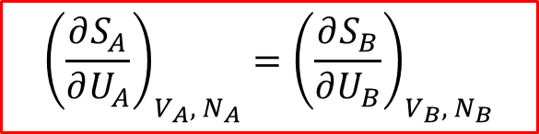

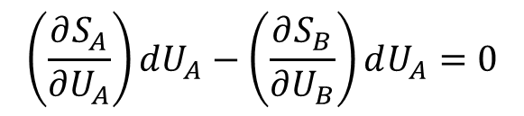



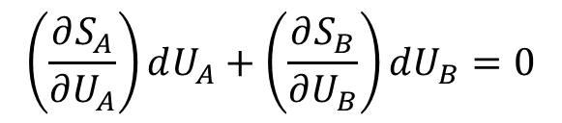
In equilibrium,
Equilibrium can be
Thermal – exchange of U
Mechanical – exchange of V
Diffusive – exchange of N
S is maximum
$$dS=0$$
Energy must also remain constant
$$dU_{A}+dU_{B}=0$$
For thermal equilibrium only
Exchange of energy between subsystems is allowed, while N and V are kept constant
$$\left(\frac{∂S_{A}}{∂U_{A}}\right)dU_{A}+\left(\frac{∂S_{B}}{∂U_{B}}\right)dU_{B}=0$$
$dS=0$
$$\left(\frac{∂S_{A}}{∂U_{A}}\right)dU_{A}−\left(\frac{∂S_{B}}{∂U_{B}}\right)dU_{A}=0$$
Since $dU_{A}=−dU_{B}$
$${\left(\frac{∂S_{A}}{∂U_{A}}\right)}_{V_{A}, N_{A}}={\left(\frac{∂S_{B}}{∂U_{B}}\right)}_{V_{B}, N_{B}}$$
------ eq (1)

Slide 9

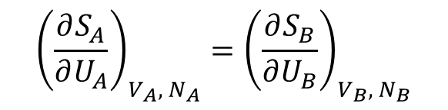
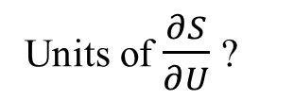

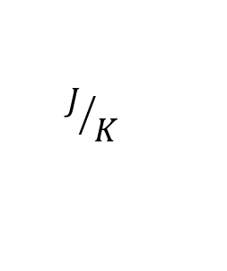
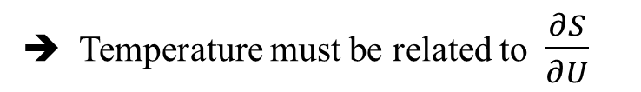
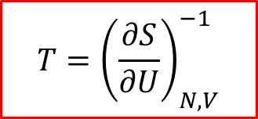
We also know that in thermal equilibrium
$$T_{A}=T_{B}$$
$${\left(\frac{∂S_{A}}{∂U_{A}}\right)}_{V_{A}, N_{A}}={\left(\frac{∂S_{B}}{∂U_{B}}\right)}_{V_{B}, N_{B}}$$
Comparing this with eq (1)
➔ Temperature must be related to $\frac{∂S}{∂U}$
Units will help us
S has units of ?
$$J/K$$
U has units of ?
J
Units of $\frac{∂S}{∂U}$ ?
$$K^{−1}$$
Therefore,
$$T={\left(\frac{∂S}{∂U}\right)}_{N, V}^{−1}$$
Definition of Temperature

Slide 10
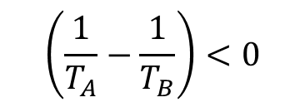
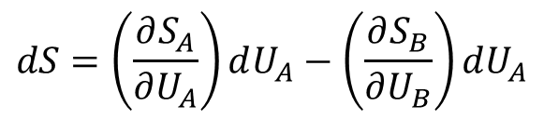



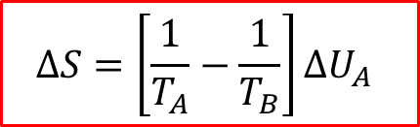

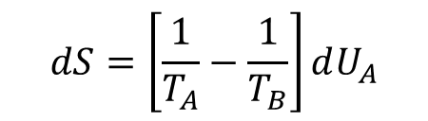
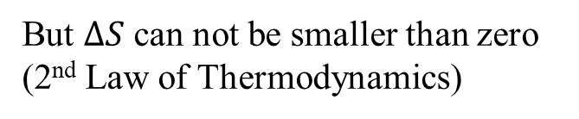
Why energy transfers from high temperature to low temperature object
$$dS=\left(\frac{∂S_{A}}{∂U_{A}}\right)dU_{A}−\left(\frac{∂S_{B}}{∂U_{B}}\right)dU_{A}$$
If $dS≠0$ Then,
While V_{A}, V_{B}, N_{A} and N_{B} are constant
$$dS=\left[\frac{1}{T_{A}}−\frac{1}{T_{B}}\right]dU_{A}$$
So for $dS≥0$
$$∆S=\left[\frac{1}{T_{A}}−\frac{1}{T_{B}}\right]∆U_{A}$$
Suppose initially $T_{A}>T_{B}$
$$\left(\frac{1}{T_{A}}−\frac{1}{T_{B}}\right)<0$$
But $∆S$ can not be smaller than zero (2nd Law of Thermodynamics)
Therefore $∆U_{A}<0$
If System A is at higher temperature, energy must transfer from system A to system B
Energy must flow from higher temperature to low temperature

Slide 11



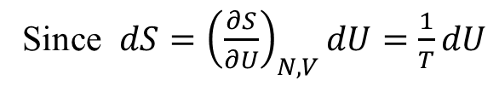
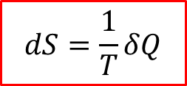
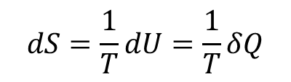


For pure heating or cooling case
(that is zero work done)
Since $dS={\left(\frac{∂S}{∂U}\right)}_{N, V}dU=\frac{1}{T}dU$
As V is constant, work done is zero
( W = - PdV )
First Law
$$dU=δQ−PdV$$
$$dU=δQ$$
Therefore,
$$dS=\frac{1}{T}dU=\frac{1}{T}δQ$$
$$dS=\frac{1}{T}δQ$$
For Adiabatic Process
$$δQ=0$$
$$⇒ dS=0$$
OR $S=Constant$
Entropy does not change in adiabatic process
A process that is quasistatic and adiabatic, is called Isentropic process

Slide 12


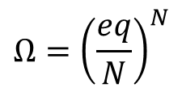
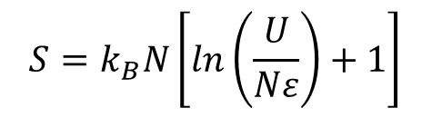


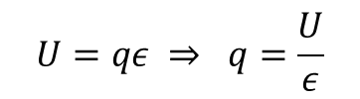

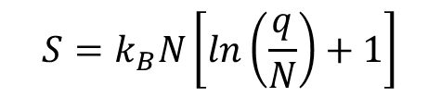
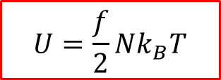
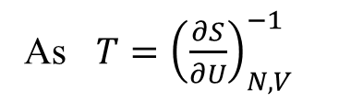

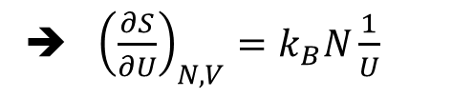
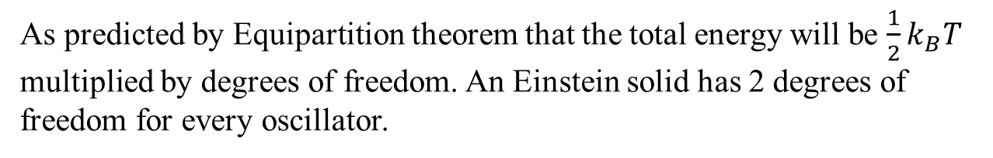
For a Large Einstein Solid
With $q≫N$
$$Ω={\left(\frac{eq}{N}\right)}^{N}$$
As $S=k_{B}ln⁡(Ω)$
N = # of oscillators
q = # of energy units
$$S=k_{B}N\left[ln\left(\frac{q}{N}\right)+1\right]$$
$$U=qε ⇒ q=\frac{U}{ε}$$
$$S=k_{B}N\left[ln\left(\frac{U}{Nε}\right)+1\right]$$
$$S=k_{B}N\left[\ln\left(U\right)−\ln\left(εN\right)+1\right]$$
➔ ${\left(\frac{∂S}{∂U}\right)}_{N, V}=k_{B}N\frac{1}{U}$
As $T={\left(\frac{∂S}{∂U}\right)}_{N, V}^{−1}$
➔ $T=\frac{U}{k_{B}N}$
$$OR$$
$$U=Nk_{B}T$$
As predicted by Equipartition theorem that the total energy will be $\frac{1}{2}k_{B}T$ multiplied by degrees of freedom. An Einstein solid has 2 degrees of freedom for every oscillator.
In general
$$U=\frac{f}{2}Nk_{B}T$$

Slide 13

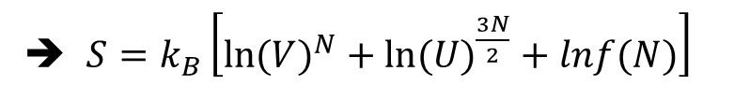


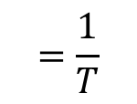
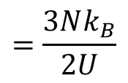
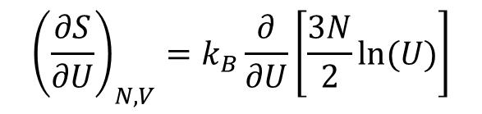
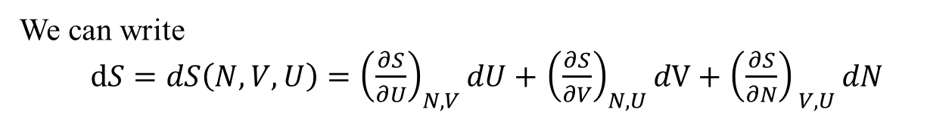
For monatomic Ideal Gas
$$Ω=f(N)V^{N}U^{\frac{3N}{2}}$$
➔ $S=k_{B}\left[ln⁡({V)}^{N}+ln⁡({U)}^{\frac{3N}{2}}+lnf(N)\right]$
$${\left(\frac{∂S}{∂U}\right)}_{N, V}=k_{B}\frac{∂}{∂U}\left[\frac{3N}{2}ln⁡(U)\right]$$
$$=\frac{3Nk_{B}}{2U}$$
$$=\frac{1}{T}$$
$$U=\frac{3}{2}Nk_{B}T$$
S is one of Thermodynamic Identities
As $S=S(N, V, U)$
We can write
$dS=dS\left(N, V, U\right)={\left(\frac{∂S}{∂U}\right)}_{N, V}dU+$ ${\left(\frac{∂S}{∂V}\right)}_{N, U}dV+$ ${\left(\frac{∂S}{∂N}\right)}_{ V, U}dN$

Slide 14
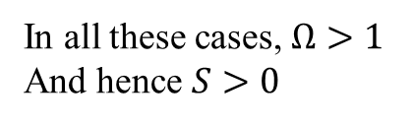

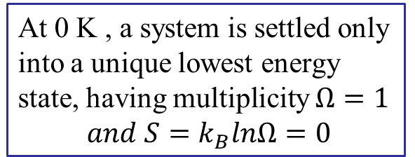

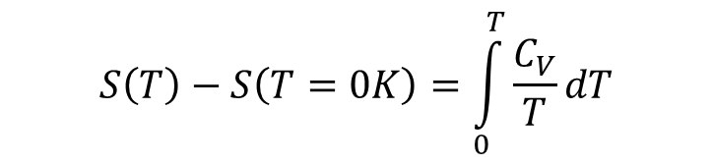
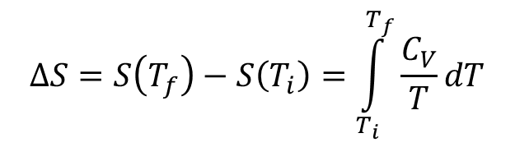

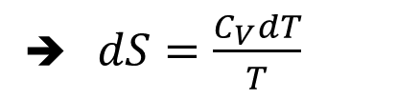
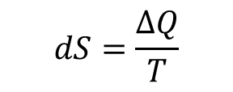
Measuring Entropy
$$dS=\frac{∆Q}{T}$$
As $dS=\frac{dU}{T}$
for constant volume
If no phase change is involved
$$ΔQ=C_{V}dT$$
➔ $dS=\frac{C_{V}dT}{T}$
If T changes significantly
$$ΔS=S\left(T_{f}\right)−S\left(T_{i}\right)=\int_{T_{i}}^{T_{f}}{\frac{C_{V}}{T}dT}$$
Average T
C_{V} is usually constant over a temperature range of interest
$$S\left(T\right)−S\left(T=0K\right)=\int_{0}^{T}{\frac{C_{V}}{T}dT}$$
At 0 K , a system is settled only into a unique lowest energy state, having multiplicity $Ω=1$
$$and S=k_{B}lnΩ=0$$
S at 0 K , in principle is zero
$$S(T→0)→0$$
3rd Law of Thermodynamics
However, there is a residual Entropy at 0K due to:
Crystal may be frozen in various orientations.
There may be more than one lowest energy states.
Solids may have different isotopes.
Multiple orientations of nuclear spin
degeneracy
In all these cases, $Ω>1$
And hence $S>0$

Slide 15

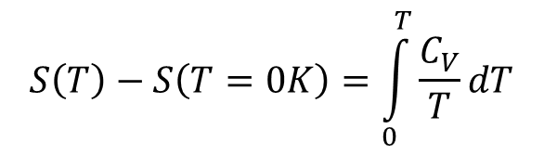

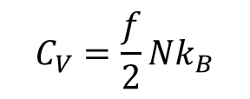

As T → 0
$$S\left(T\right)−S\left(T=0K\right)=\int_{0}^{T}{\frac{C_{V}}{T}dT}$$
diverges
The only way out is
$$C_{V}(T→0)→0$$
Another form of 3rd Law
Like
$$S(T→0)→0$$
In Ch 1, we had
$$C_{V}=\frac{f}{2}Nk_{B}$$
apparently wrong at very low temperature
Experimental data shows
$$C_{V}\left(T\right)=AT+BT^{3}$$
in low temperature range
Electronic contribution
Lattice contribution

Slide 16
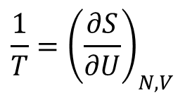
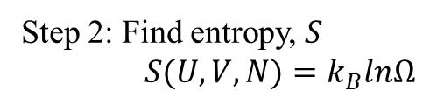

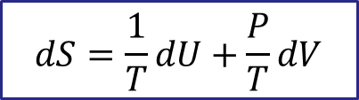

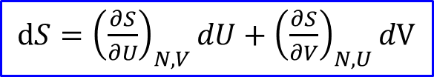
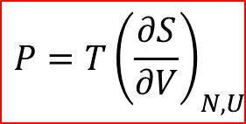

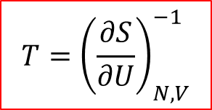

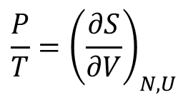
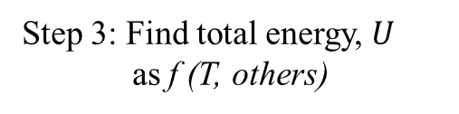
Thermodynamic Identity Equation
We have $dS=\frac{dQ}{T}$
Also 1st Law
$$dU=dQ−PdV$$
$$dS=\frac{1}{T}dU+\frac{P}{T}dV$$
$$dU=TdS−PdV$$
---------- Eq (1)
$dS(U, V, N)={\left(\frac{∂S}{∂U}\right)}_{N, V}dU+$ ${\left(\frac{∂S}{∂V}\right)}_{N, U}dV+$ ${\left(\frac{∂S}{∂N}\right)}_{ V, U}dN$
If N is kept constant
$dS={\left(\frac{∂S}{∂U}\right)}_{N, V}dU+$ ${\left(\frac{∂S}{∂V}\right)}_{N, U}dV$
------- Eq (2)
Comparing Eq (1) and Eq (2)
$${\frac{1}{T}=\left(\frac{∂S}{∂U}\right)}_{N, V}$$
$${\frac{P}{T}=\left(\frac{∂S}{∂V}\right)}_{N, U}$$
Step 1: Find multiplicity, $Ω$
and
Step 2: Find entropy, $S$
$S(U, V, N)=k_{B}lnΩ$
$$T={\left(\frac{∂S}{∂U}\right)}_{N, V}^{−1}$$
$${P=T\left(\frac{∂S}{∂V}\right)}_{N, U}$$
Step 3: Find total energy, $U$
as f (T, others)
Get T, P and C_{V}

Slide 17
Assignment#5 Due 3/4/2022
3.5, 3.13, 3.19, 3.23, 3.33, and 3.36.
Problems for practice of Ch 3:
3.1, 3.6, 3.9, 3.10, 3.11, 3.25 (a, b, c and d only), 3.27, 3.28, 3.32, and 3.34.
Exam 1 Covering Ch 1 through Ch 3
3/4/2022
Next: Paramagnetism, Mechanical and diffusive equilibrium

